Slide 1
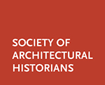
A Roundtable Discussion
FUTURE DESIGN SOLUTIONS
FOR BUFFALO
Paul Goldberger
Catherine Schweitzer, Robert Shibley

Slide 2
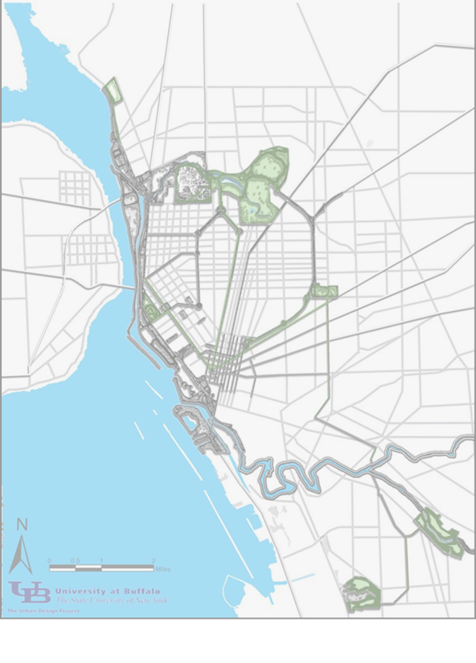
Preservation as a Performing Art
Future Design Solutions for Buffalo
The play never ends. The authors are the actors.
The essence of what we seek is in quality relationships among people and place.
Notes:
Agenda:
Peter Vail Vail speaks of Management Science as a performance art
Vincent Ostrum defines Public Administration as the art of designing organizations which design themselves (Public Administration Review article on Artisanship and Artifact July/August 1980)

Slide 3
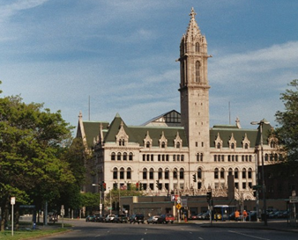
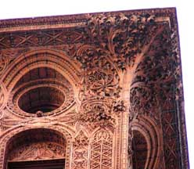
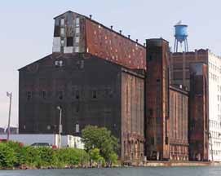
The performance builds on strong previous work
Decades of success and failure in preservation
Stronger preservation organizations
Continuing participation
Using the best from work over a decade

Slide 4
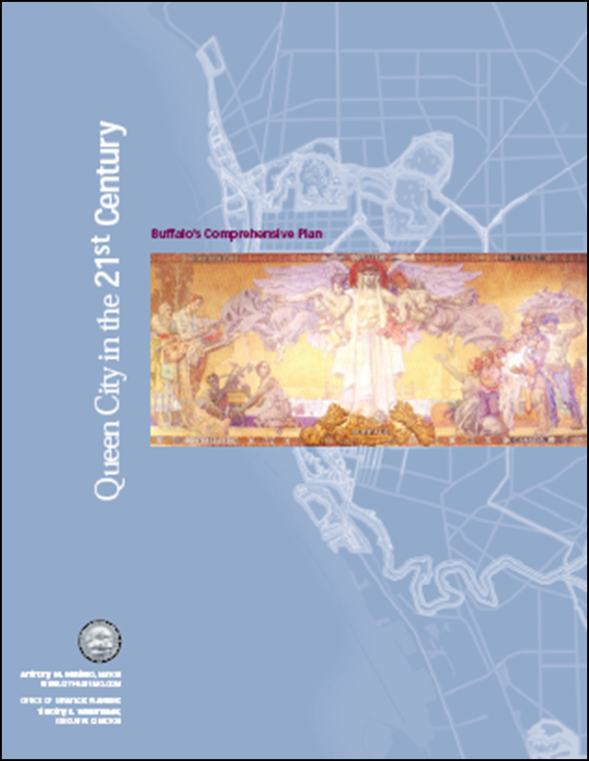
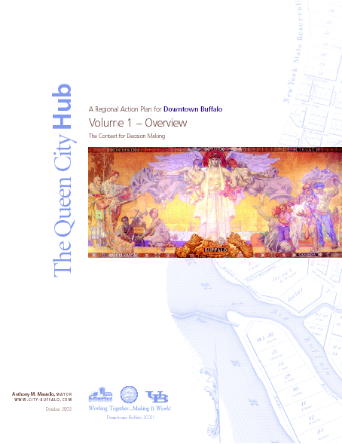
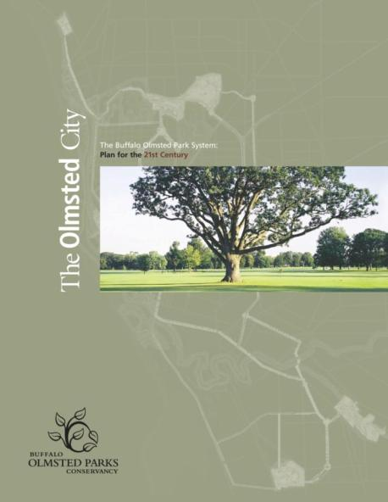
Aligned with Buffalo’s planning framework
The Queen City Hub
The Queen City Waterfront
The Olmsted City
The Queen City in the 21st Century
The Buffalo Green Code
All of these reinforce the important role that historic preservation must play in the regeneration of our city.
2006
2003
2007
2008

Slide 5
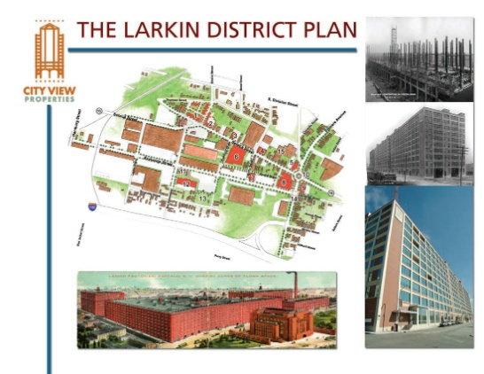

Three plan types from precedent work
2006
Stand-alone plans
Plans embedded in strong comprehensive plans
Plans emerging incrementally from district designations
Policy tools
Why not hybrid plans and policy tools that coordinate
the best features of each of the three types?
2013

Slide 6
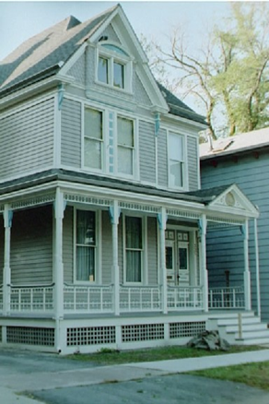
The basics of most preservation plans
Inventory historic resources
Protect those resources
Educate the public (K-12, legislative, and elements thereof)
Build capacity to do the first three jobs well
  Administrative
  Financial
  Technical

Slide 7
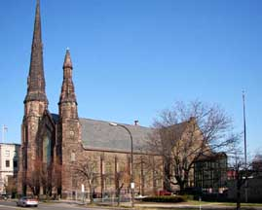
This must be a partnership plan
It’s about public policy and public administration…
How it dovetails with private development and not-for-profit action …
How it’s supported by the philanthropic community
None of the participants can do it alone;
We will all be most successful if we work together;
The plan will help identify who does what.

Slide 8
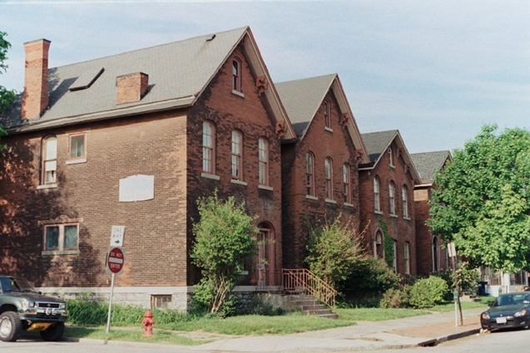
The plan will make the case for preservation
The particular meaning of life in Buffalo
Sustaining the “web of urbanism”
Attracting residents, visitors, capital
Reinvesting in neighborhoods

Slide 9
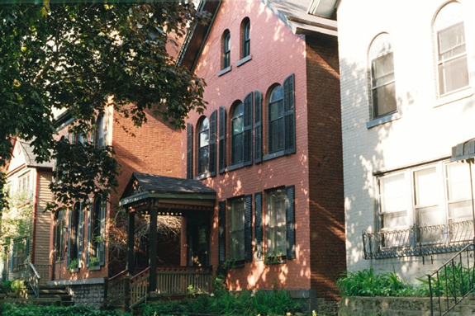
A complete inventory of historic resources
Landmarks
Historic districts
Residential and other properties
Streets and pedestrian ways
Landscape features

Slide 10
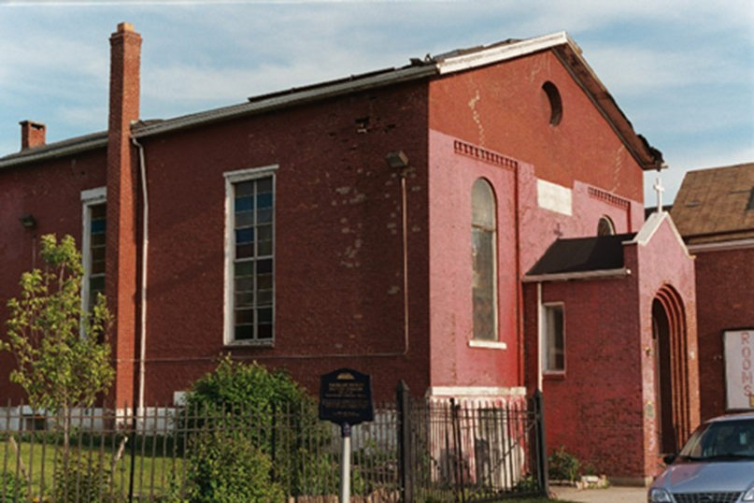
We will use the standard criteria:
Association with significant people or events
Significance of building type, architectural style, period, builder, or architect
Significance of context or surrounding urban fabric

Slide 11
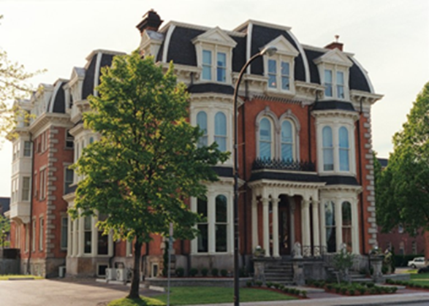
Protection embedded in public policy
Sustain the “web of urbanism”
Pedestrian-oriented approaches to redevelopment
Unify landscapes and streetscapes
Provide guidelines for new development
Secure buildings for later redevelopment

Slide 12
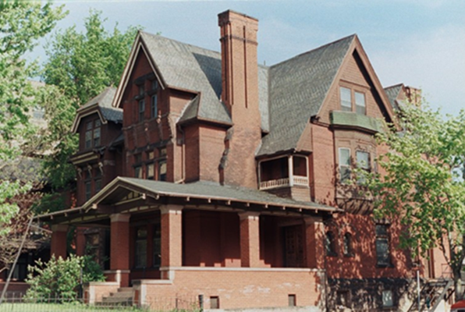
Education to support preservation
Protecting Buffalo’s Best – guide to the process
Info for front-line tourism industry workers
Staff of courts, public agencies, others
Programs for school children
And for the general public
Tours, conferences, publications

Slide 13
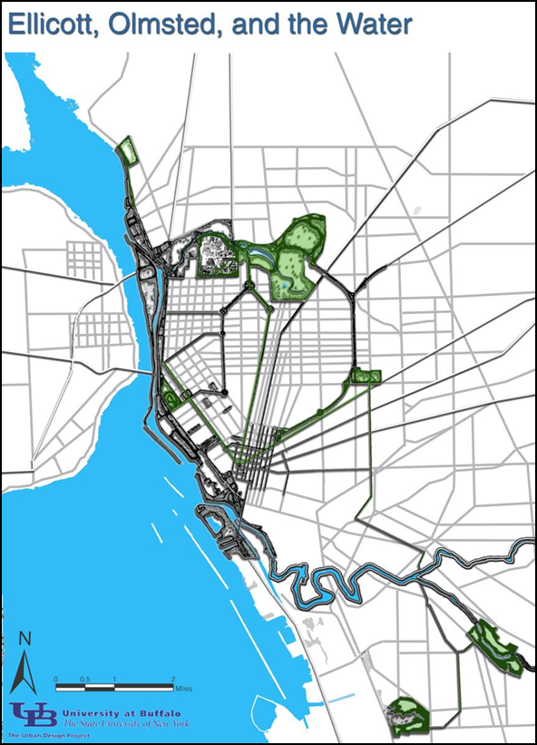
Capacity to inventory, protect, educate
Financial, administrative, technical support
A self-sustaining preservation organization
Strategic resource fund
Coordination with work on housing and neighborhoods, Olmsted Parks, Ellicott radials, schools…

Slide 14
Some issues to resolve going forward in the performance art of preservation
Things we normally expect
  Clear, transparent, accountable process
  Widely available information
  Sorting out who does what
  Identifying the needed resources – public + private
  Setting priorities for inventory, nomination, preservation

Slide 15
But first consider risking collaboration and then the motives people have for action
Preconditions to trust during the performing
  Reciprocal surrender
  Forgiveness
  Wonder
  Appreciation
Consideration for motives of all actors in the performance
  Aesthetics
  Politics
  Social Status
  Science
  Ethics
Language matters. Is “preservation” the right name for what we do.
Do the math while knowing it is never all about the money
But you can not collaborate
with pathologic realities --
-- Or --
Don’t take a knife to a gun fight!!
Don’t be too quick to declare pathologies.

